Slide 1
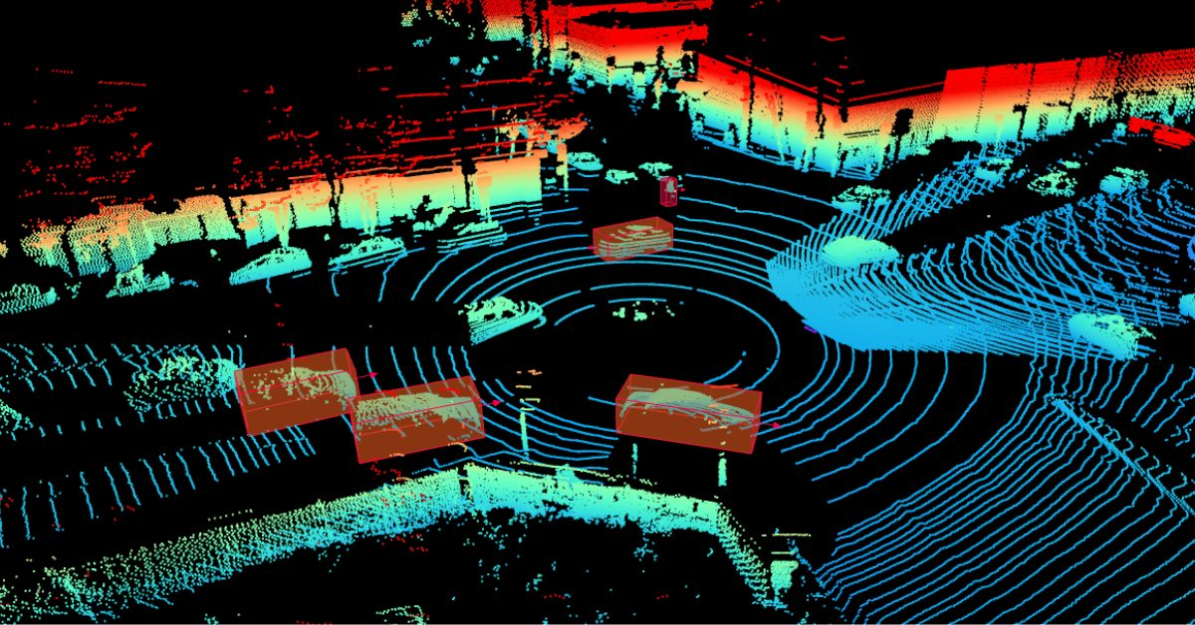

3D Point Cloud Processing

Slide 2
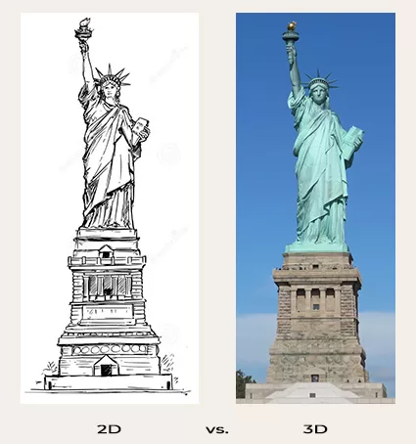
3D Point Clouds
Imagine you’re standing in front of a beautiful statue. When you look at it from the front, you see its width and height, much like looking at a photograph — a representation in two dimensions. However, if you could walk around the statue, you would also perceive its depth, seeing it from different angles — front, back, sides, and even from above or below. This ability to view objects in three dimensions is at the heart of 3D computer vision.

Slide 3
Importance of 3D Point Clouds
3D point clouds offer a richer and more accurate representation of the real world compared to traditional two-dimensional data.
By capturing spatial information in three dimensions, point clouds provide depth, shape, and spatial relationships of objects and environments.

Slide 4
Applications of 3D Point Clouds
Robotics: From self-driving cars to warehouse robots, point clouds help robots “see” the world in 3D, enabling them to navigate safely and efficiently.
City Builders: Architects and planners use point clouds to create digital models of cities, helping them design new buildings, improve infrastructure, and even simulate future development.
VR & AR Magic: 3D point clouds power stunning AR/VR experiences by mapping real-world spaces and allowing digital objects to interact with them, making training, entertainment, and visualization more immersive.
Earth Watchers: Scientists use point clouds to study Earth’s surface, from creating detailed maps to monitoring forests and water resources, helping us understand and protect our planet.
Factory: In manufacturing, point clouds ensure quality by letting robots inspect products against digital models, leading to fewer defects, less waste, and smoother production.

Slide 5
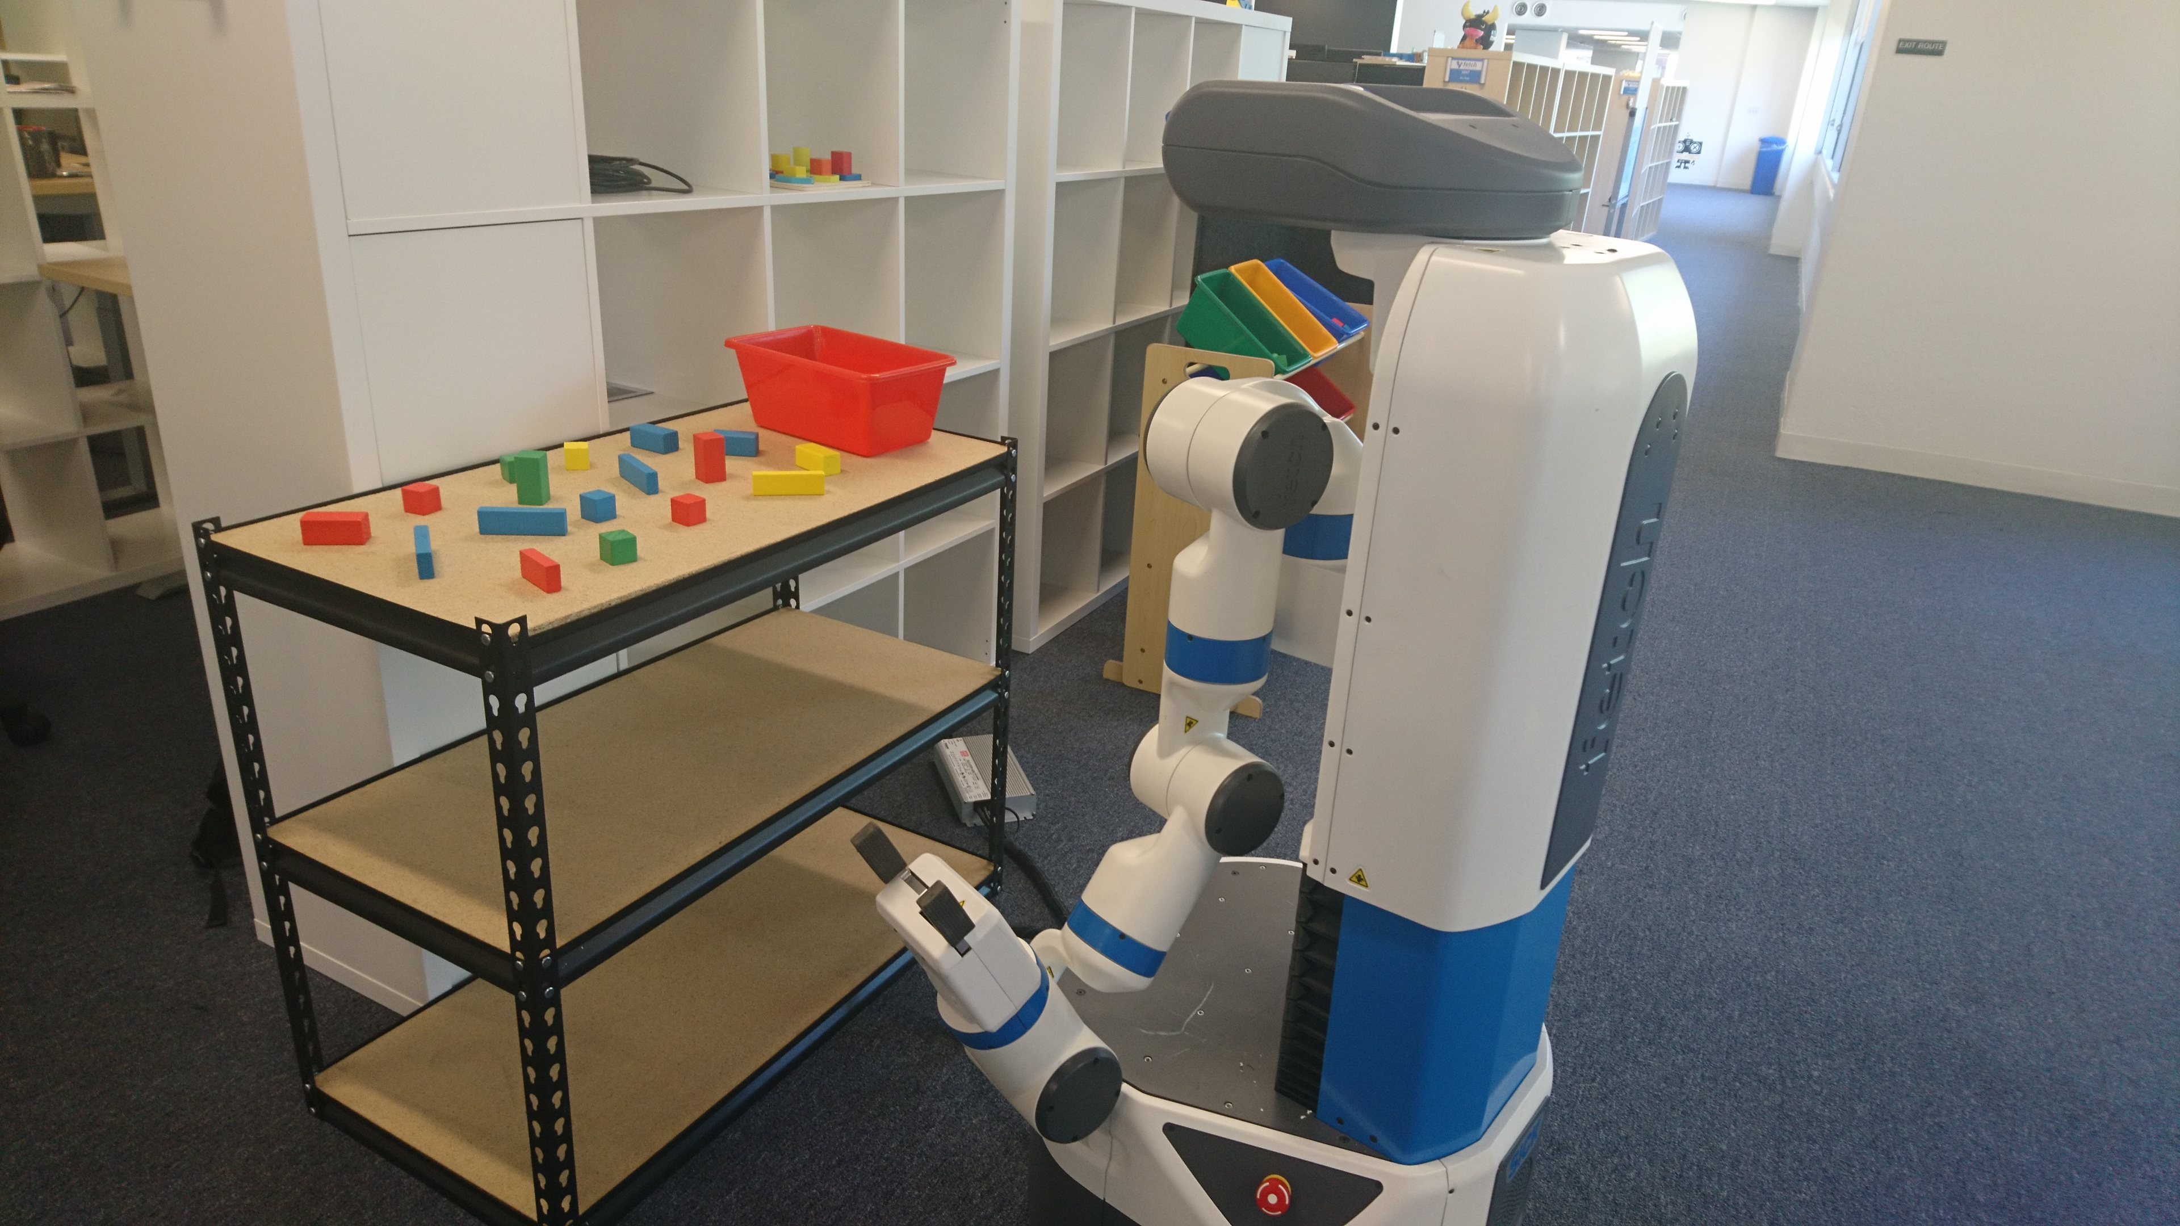
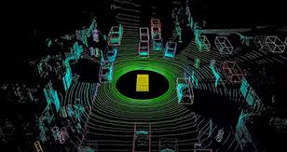
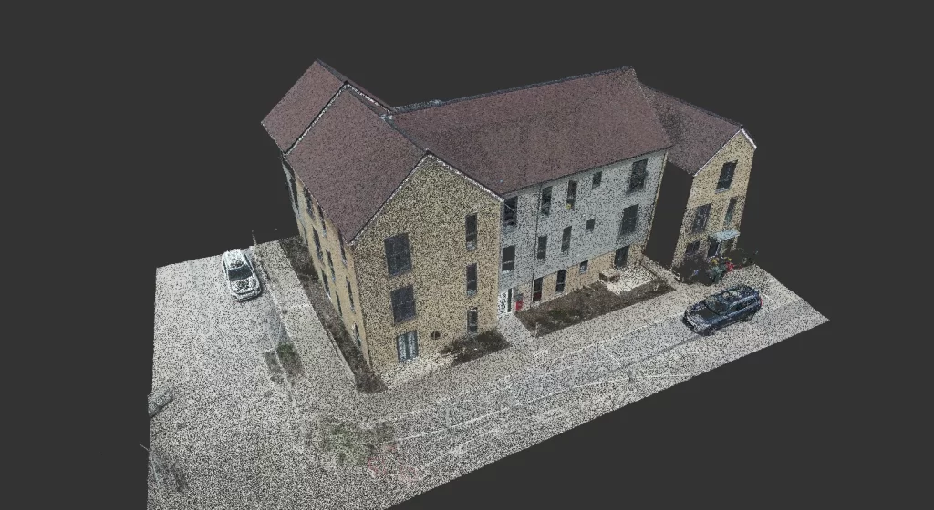
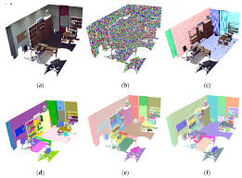
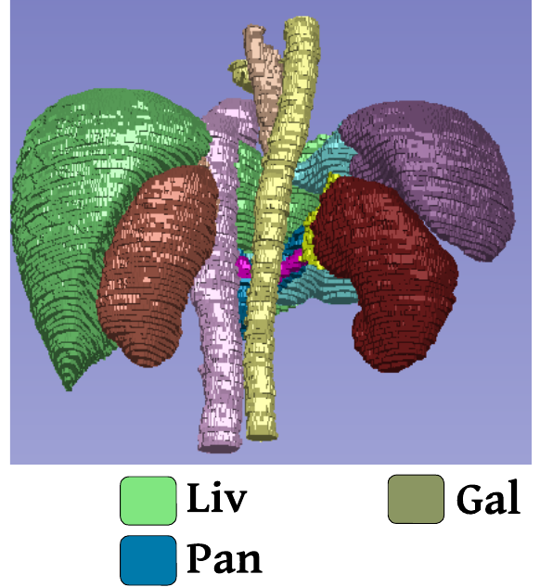
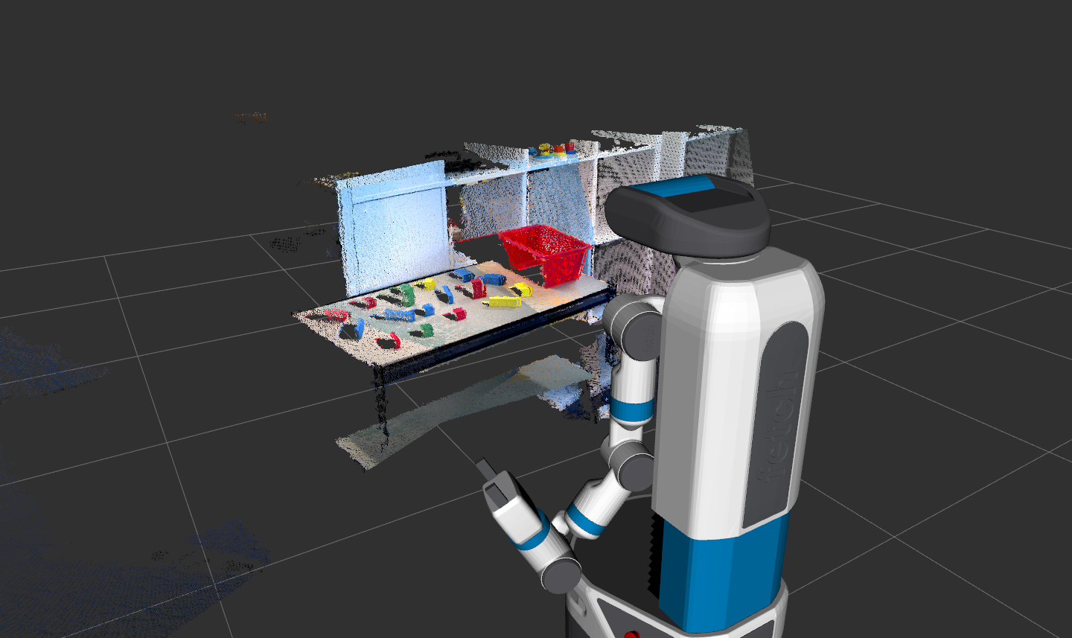
Applications of 3D Point Clouds

Slide 6
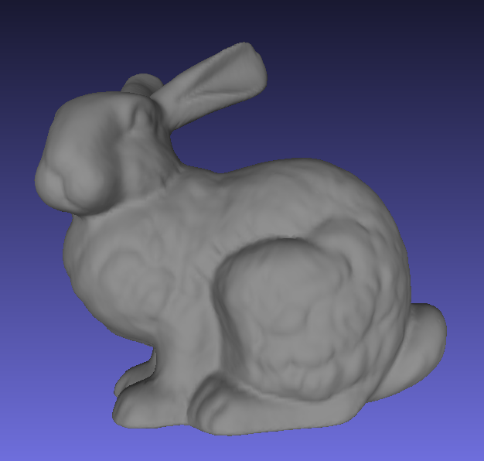
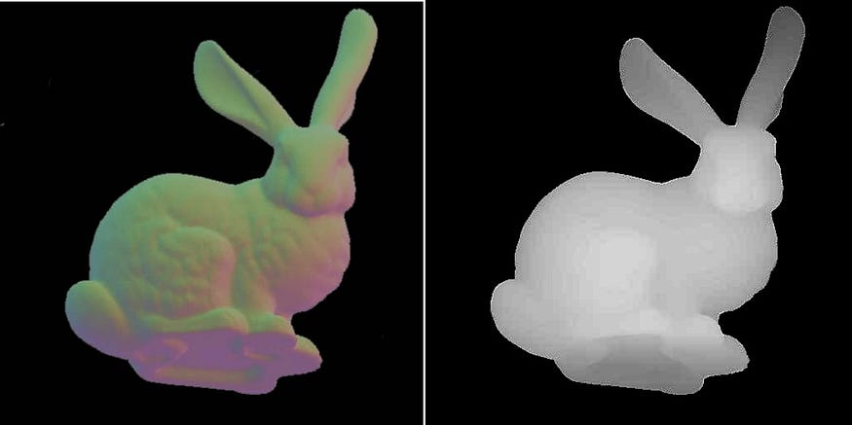
2D-2.5D-3D Data
2D
Width & height
2.5D
Depth map
3D
Points in 3D space (Illustrated with surface)

Slide 7
2D-2.5D-3D Data
2D Data (Image): A photograph captures a mountain’s width and height while lacking depth.
3D Data (Point Cloud): Imagine a point cloud generated from LiDAR scanning of the mountain. Each point in the cloud represents a specific location in 3D space, including x-coordinate, y-coordinate, and z-coordinate(depth).
2.5D Data (Depth Map): A depth map of the mountain provides a 2.5D representation. It includes depth information alongside width and height but doesn’t offer a complete 3D model. For example, a depth map of a room indicates the distance of objects in the room from the depth camera but not a full 3D representation. Each depth value corresponds to a specific 2D coordinate (x, y) in the map, indicating the distance of that point from the depth camera. Note that each depth value is represented in 2D coordinates only. For example, at the (100, 200) location, the depth is 3.5meter.

Slide 8
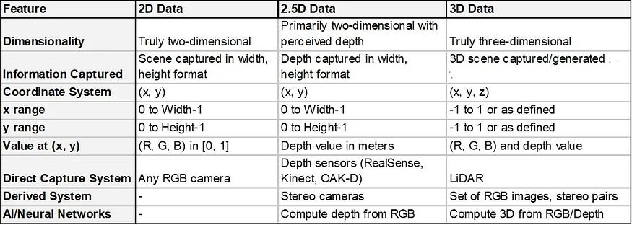
2D-2.5D-3D Data

Slide 9
How to generate 2.5D Data?
Depth maps can be captured using specialized depth cameras or computed from stereo images.
Depth map is captured by depth cameras including Intel Real sense, Azure Kinect
Alternatively, they can be computed using two stereo images (RGB/Gray) capturing the same scene/object with two shifted cameras. These stereo images capture the same scene from slightly different angles, allowing algorithms to calculate the relative distance of objects from the camera. This information is then used to create a depth map, providing a 2.5D representation of the scene.
In depth maps, each (x, y) represents depth values in millimeters or meters. This depth map of size width x height is projected as a 3D point cloud using a projection matrix using depth camera parameters.

Slide 10
How to generate 2.5D Data?
Depth maps can be captured using specialized depth cameras or computed from stereo images.
Depth map is captured by depth cameras including Intel Real sense, Azure Kinect
Alternatively, they can be computed using two stereo images (RGB/Gray) capturing the same scene/object with two shifted cameras. These stereo images capture the same scene from slightly different angles, allowing algorithms to calculate the relative distance of objects from the camera. This information is then used to create a depth map, providing a 2.5D representation of the scene.
In depth maps, each (x, y) represents depth values in millimeters or meters. This depth map of size width x height is projected as a 3D point cloud using a projection matrix using depth camera parameters.

Slide 11
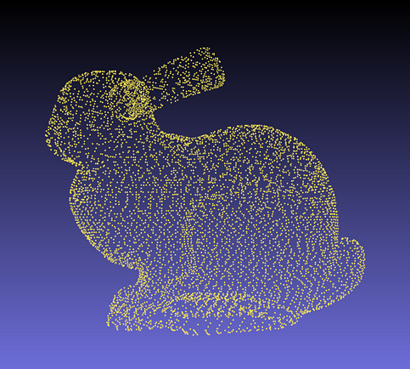
3D Data
It consists of a collection of 3D points represented as arrays in various file formats such as PCD and OBJ
3D data is essentially a collection of individual points in 3D space, each with its own x, y, and z coordinates. These points come together to form a complete representation of an object or scene.

Slide 12
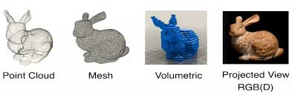
3D Data Types
Point Clouds: Point clouds are a fundamental data type in 3D computer vision and represent surfaces as a collection of points in 3D space. Each point in a point cloud is defined by its x, y, and z coordinates, which specify its position in the 3D world. Additionally, points in a point cloud may include other attributes such as color, intensity, or surface normals, which provide further information about the object’s appearance and structure.
Meshes: A mesh is another common representation of 3D objects, defined by a set of vertices, edges, and faces. Vertices are points in 3D space, edges connect vertices, and faces are flat surfaces formed by connecting edges. Meshes are used to define the shape of an object’s surface with more detail than point clouds, as they can accurately represent the geometry of complex surfaces.
Volumetric Data: Volumetric data represents objects as a 3D grid, where each cell in the grid (voxel) contains information about the object’s properties at that point in space. This type of data is useful for representing objects that have volume, such as medical images of organs or industrial scans of machinery. Volumetric data can capture both the exterior surface and interior properties of objects, making it valuable for a wide range of applications.

Slide 13
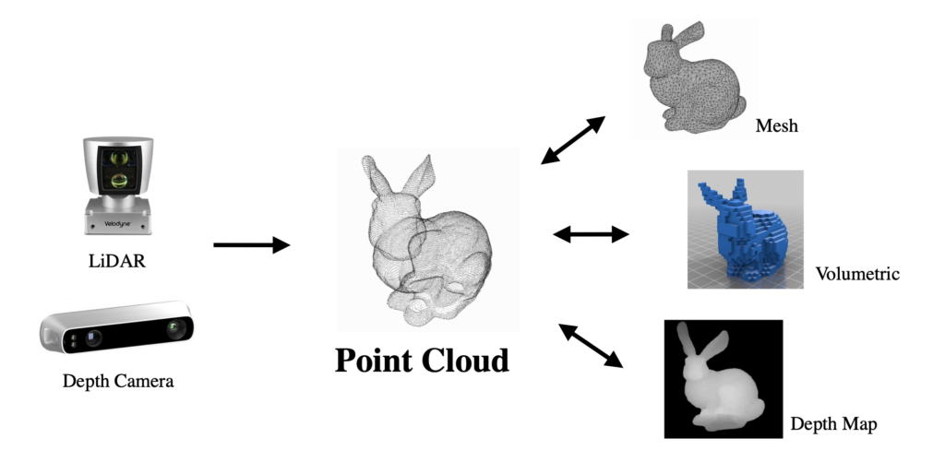
Point Cloud, mesh, volumetric & depth map

Slide 14
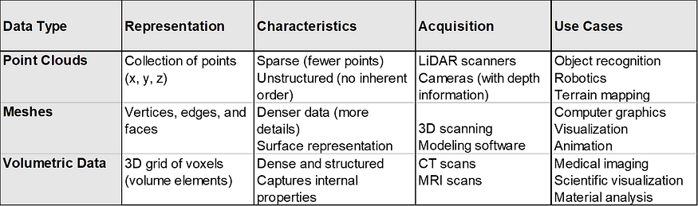
Point Cloud, mesh, volumetric & depth map

Slide 15
Key differences of 3D data types
Sparsity/Density: Point clouds are sparse, meaning they contain fewer data points compared to meshes and volumetric data. Point clouds are the sparsest, followed by meshes, and volumetric data is the densest.
Structure: Point clouds are unstructured, Meshes have a defined structure with defined relationships between data points and volumetric data are structured and organized in grid-like structure.
Information captured: Point clouds capture basic 3D coordinates, meshes capture surface details, and volumetric data captures both surface and interior details.
Acquisition methods: LiDAR and cameras are commonly used for capturing point clouds, while scanning and modeling software are used for meshes, and CT and MRI scans are used for volumetric data.

Slide 16
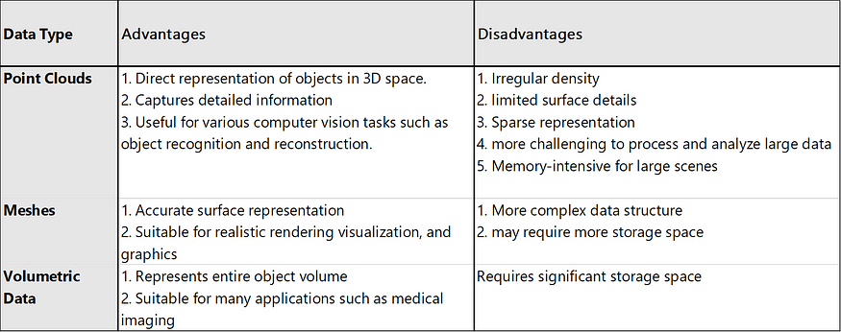
Advantages VS Disadvantages
In summary, each data type has its strengths and weaknesses.
The choice of data type depends on the specific requirements of the application and the balance between accuracy, complexity, and resource requirements.

Slide 17
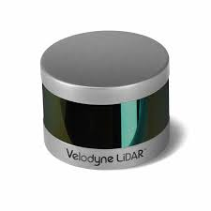
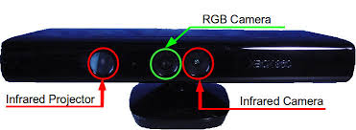
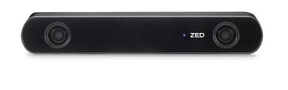
Sensors for capturing 3D data
Stereo
RGB-D
LIDAR

Slide 18
Sensors for capturing 3D data
Stereo Cameras: Utilize two cameras which capture images from two slightly offset lenses and its disparities. The disparities between corresponding points in the images are used to calculate depth and generate point clouds.
RGB-D Cameras: These cameras combine a regular RGB camera with an infrared depth sensor. They capture both color (RGB) and depth (D) information for each pixel and creating a synchronized point cloud.
LiDAR (Light Detection and Ranging): LiDAR sensors emit laser beams and measure their reflection time to calculate distances. This enables the creation of accurate and dense point clouds with depth information.o or more known points, the object's 3D position can be derived using geometric principles.

Slide 19
How Points are Organized in 3D Space
(1, 1, 10)
(2, 1, 20)
(3, 1, 30)
(4, 1, 40)
(5, 1, 50)
(1, 2, 26)
(2, 2, 27)
(3, 2, 28)
(4, 2, 29)
(5, 2, 30)
In a typical RGB-D based 3D reconstruction pipeline, the point cloud data is usually arranged in the ply file in a row-major order.
This means that the points are listed row by row, where each row corresponds to a scanline of the depth image. The points within a scanline are listed in the order of increasing horizontal pixel positions.
10 | 20 | 30 | 40 | 50
26 | 27 | 28 | 29 | 35
11 | 12 | 13 | 14 | 15
16 | 17 | 18 | 19 | 20
21 | 22 | 23 | 24 | 25
PNG- Depth image
PLY - RGB-D Data (X, Y, Z):
(RGB color values are omitted
for simplicity)

Slide 20
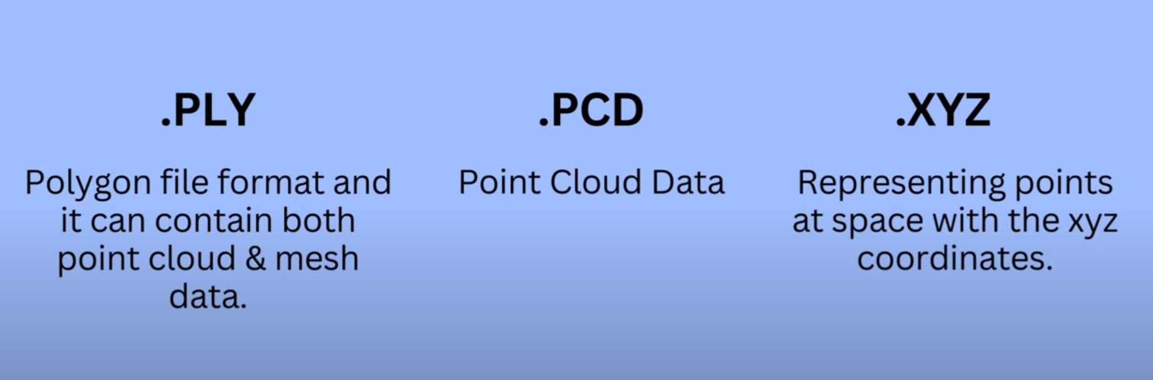
File Formats

Slide 21
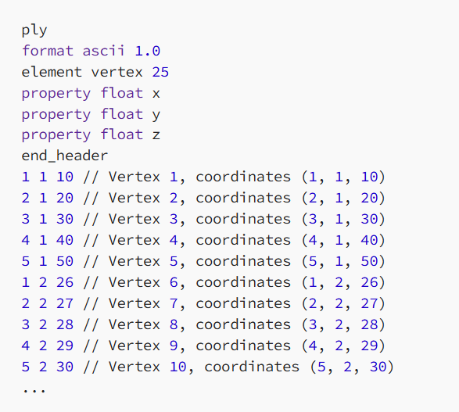
PLY file format
Note that the points (generally called vertex) are listed row by row, and within each row, they are listed in the order of increasing horizontal pixel positions.
That is, First row all columns, Second row all columns and so on. This ordering ensures that the reconstructed 3D points are aligned with the corresponding depth image pixels.

